Slide 1
Artificial intelligence
Session – 9
Date – 07th June, 2022

Slide 2
Basic Concept of HAAR Cascade Algorithm
The HAAR cascade is a machine learning approach where a cascade function is trained from a lot of positive and negative images. Positive images are those images that consist of faces, and negative images are without faces. In face detection, image features are treated as numerical information extracted from the pictures that can distinguish one image from another.
We apply every feature of the algorithm on all the training images. Every image is given equal weight at the starting. It founds the best threshold which will categorize the faces to positive and negative. There may be errors and misclassifications. We select the features with a minimum error rate, which means these are the features that best classifies the face and non-face images.
All possible sizes and locations of each kernel are used to calculate the plenty of features.

Slide 3
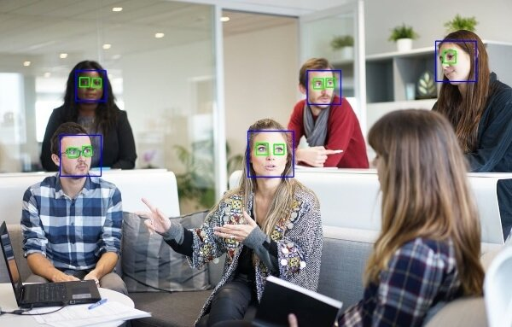
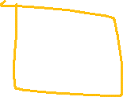


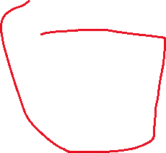


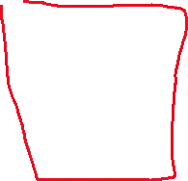
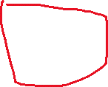






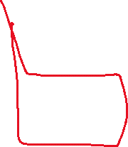
Basic Concept of HAAR Cascade Algorithm
1 | 0 | 0
1 | 1 | 0
0 | 1 | 0
0 | 0 | 1
1 | 1 | 1
0 | 1 | 0

Slide 4
HAAR-Cascade Detection in OpenCV
OpenCV provides the trainer as well as the detector. We can train the classifier for any object like cars, planes, and buildings by using the OpenCV. There are two primary states of the cascade image classifier first one is training and the other is detection.
OpenCV provides two applications to train cascade classifier opencv_haartraining and opencv_traincascade. These two applications store the classifier in the different file format.
For training, we need a set of samples. There are two types of samples:
Negative sample: It is related to non-object images.
Positive samples: It is a related image with detect objects.
A set of negative samples must be prepared manually, whereas the collection of positive samples are created using the opencv_createsamples utility.

Slide 5
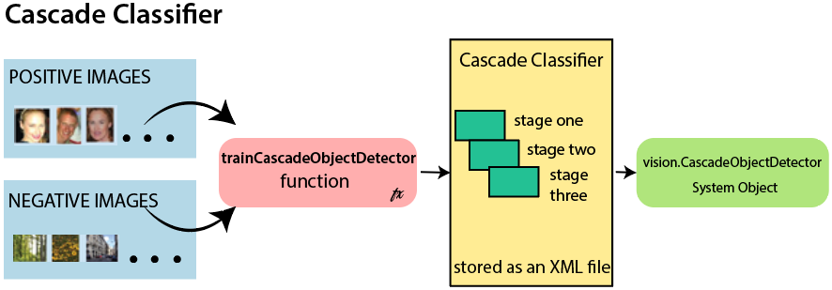
HAAR-Cascade Detection in OpenCV
Negative Sample
Negative samples are taken from arbitrary images. Negative samples are added in a text file. Each line of the file contains an image filename (relative to the directory of the description file) of the negative sample. This file must be created manually. Defined images may be of different sizes.
Positive Sample
Positive samples are created by opencv_createsamples utility. These samples can be created from a single image with an object or from an earlier collection. It is important to remember that we require a large dataset of positive samples before you give it to the mentioned utility because it only applies the perspective transformation.

Slide 6
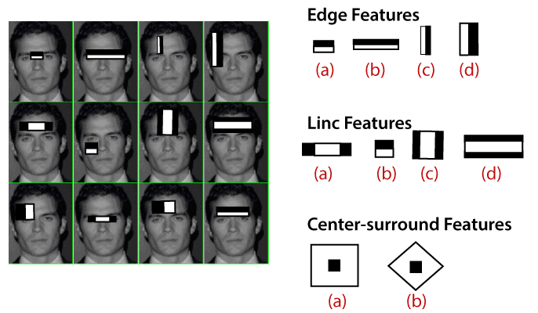
HAAR-Cascade Detection in OpenCV
Here we will discuss detection. OpenCV already contains various pre-trained classifiers for face, eyes, smile, etc. Those XML files are stored in opencv/data/haarcascades/ folder. Let's understand the following steps:
Step - 1
First, we need to load the necessary XML classifiers and load input images (or video) in grayscale mode.
Step -2
After converting the image into grayscale, we can do the image manipulation where the image can be resized, cropped, blurred, and sharpen if required. The next step is image segmentation; identify the multiple objects in the single image, so the classifier quickly detects the objects and faces in the picture.
Step - 3
The haar-Like feature algorithm is used to find the location of the human faces in frame or image. All the Human faces have some common universal properties of faces like the eye region is darker than it's neighbor's pixels and nose region is more bright than the eye region.
Step -4
In this step, we extract the features from the image, with the help of edge detection, line detection, and center detection. Then provide the coordinate of x, y, w, h, which makes a rectangle box in the picture to show the location of the face. It can make a rectangle box in the desired area where it detects the face.

Slide 7
Face recognition using OpenCV
Face recognition is a simple task for humans. Successful face recognition tends to effective recognition of the inner features (eyes, nose, mouth) or outer features (head, face, hairline). Here the question is that how the human brain encode it?
David Hubel and Torsten Wiesel show that our brain has specialized nerve cells responding to unique local feature of the scene, such as lines, edges angle, or movement. Our brain combines the different sources of information into the useful patterns; we don't see the visual as scatters. If we define face recognition in the simple word, "Automatic face recognition is all about to take out those meaningful features from an image and putting them into a useful representation then perform some classification on them".
The basic idea of face recognition is based on the geometric features of a face. It is the feasible and most intuitive approach for face recognition. The first automated face recognition system was described in the position of eyes, ears, nose. These positioning points are called features vector (distance between the points).
The face recognition is achieved by calculating the Euclidean distance between feature vectors of a probe and reference image. This method is effective in illumination change by its nature, but it has a considerable drawback. The correct registration of the maker is very hard.

Slide 8
Face recognition using OpenCV
The face recognition system can operate basically in two modes:
Authentication or Verification of a facial image-
It compares the input facial image with the facial image related to the user, which is required authentication. It is a 1x1 comparison.
Identification or facial recognition
It basically compares the input facial images from a dataset to find the user that matches that input face. It is a 1xN comparison.
There are various types of face recognition algorithms, for example:
Eigenfaces (1991)
Local Binary Patterns Histograms (LBPH) (1996)
Fisherfaces (1997)
Scale Invariant Feature Transform (SIFT) (1999)
Speed Up Robust Features (SURF) (2006)
Each algorithm follows the different approaches to extract the image information and perform the matching with the input image. Here we will discuss the Local Binary Patterns Histogram (LBPH) algorithm which is one of the oldest and popular algorithm.

